Slide 1
Machine learning for automated ultrasound guided Infant Lumbar Puncture
Capstone Project- Kickoff 2024
PI: David Kessler, MD, MSc
Technical lead: Ritvik Khandelwal
Research scholar: Kanisha Arpit Shah
Notes:
Automated Feature Recognition to Guide Infant Lumbar Puncture
Q: What should I bring to the kick-off meeting? A: It is highly recommended that you provide a concept deck, data source and supplementary reading to the students during or prior to the kick-off meeting.
Concept deck
Next steps
Data sources

Slide 2
Intros
Add name here:
Isaac Peabody (itp2109@columbia.edu)
Abhik Biswas (ab5640@columbia.edu)
Harinder Singh Mashiana (hm3008@columbia.edu)
Mohini Bhave (mb5157@columbia.edu)

Slide 3
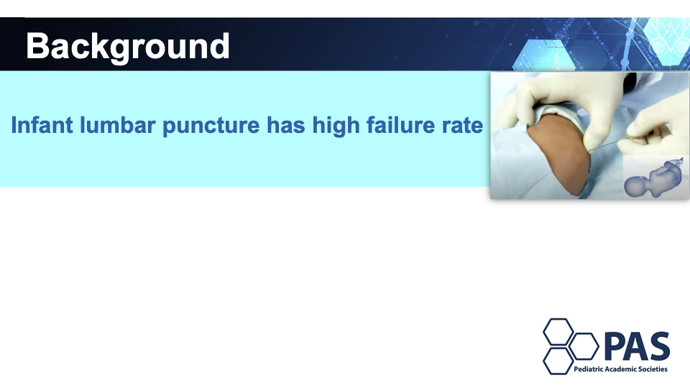
David- clinical background & goals

Slide 4
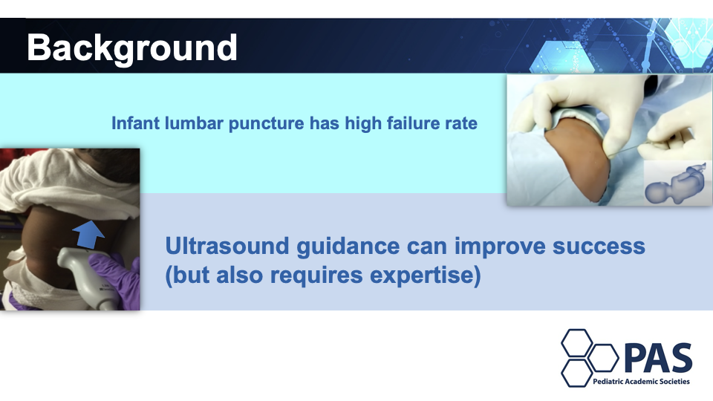

Slide 5
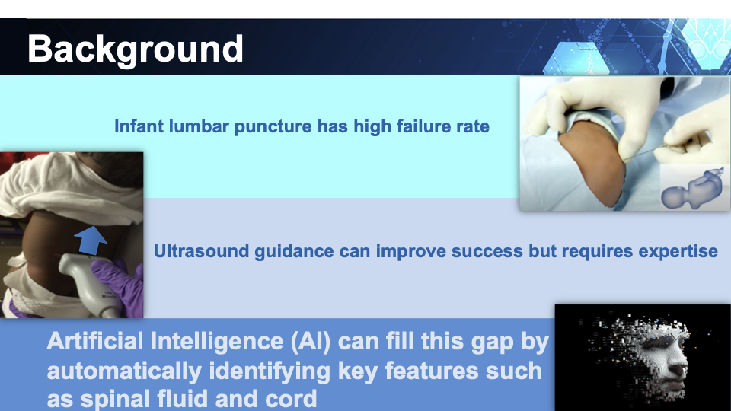

Slide 6
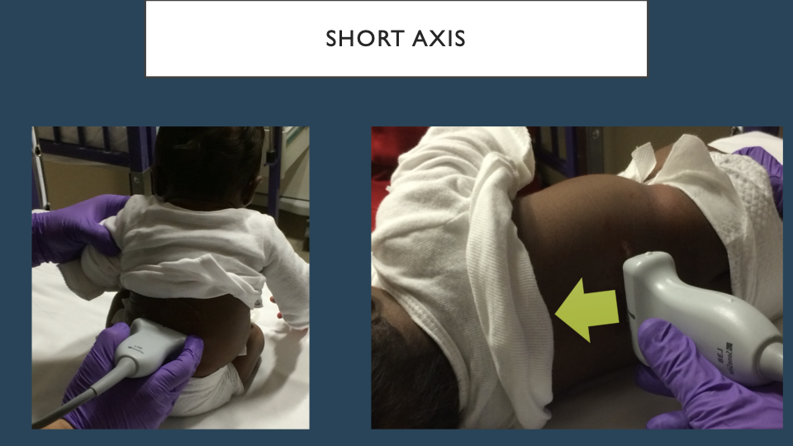

Slide 7
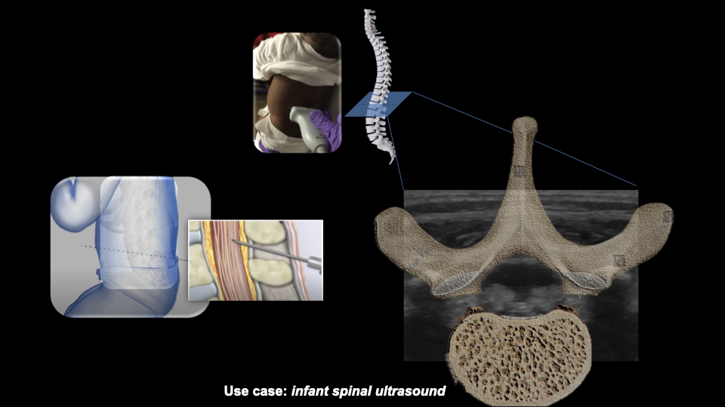

Slide 8
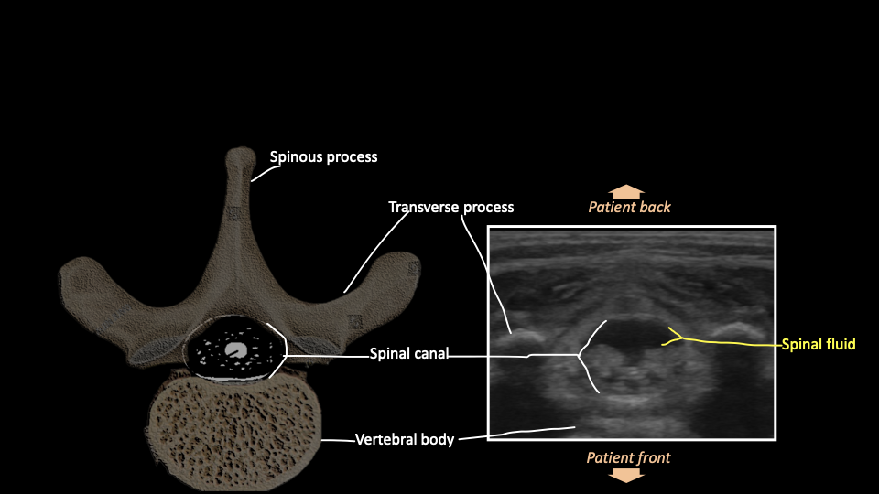
Notes:
Patient lying on belly - feet to us

Slide 9
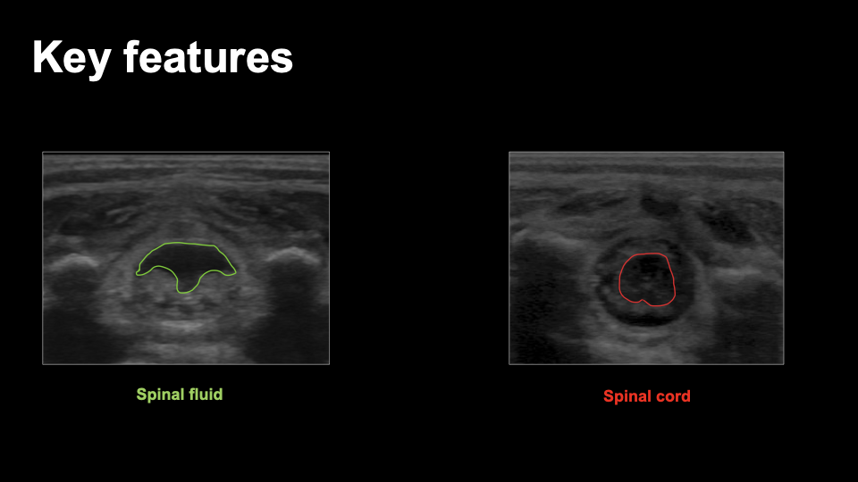

Slide 10
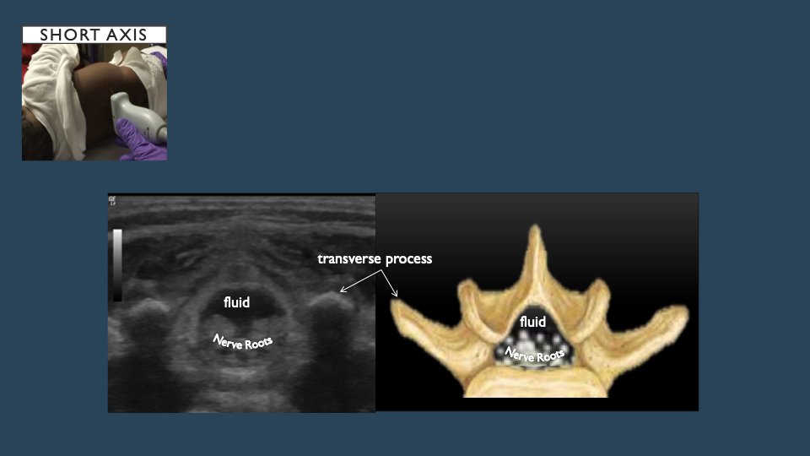

Slide 11
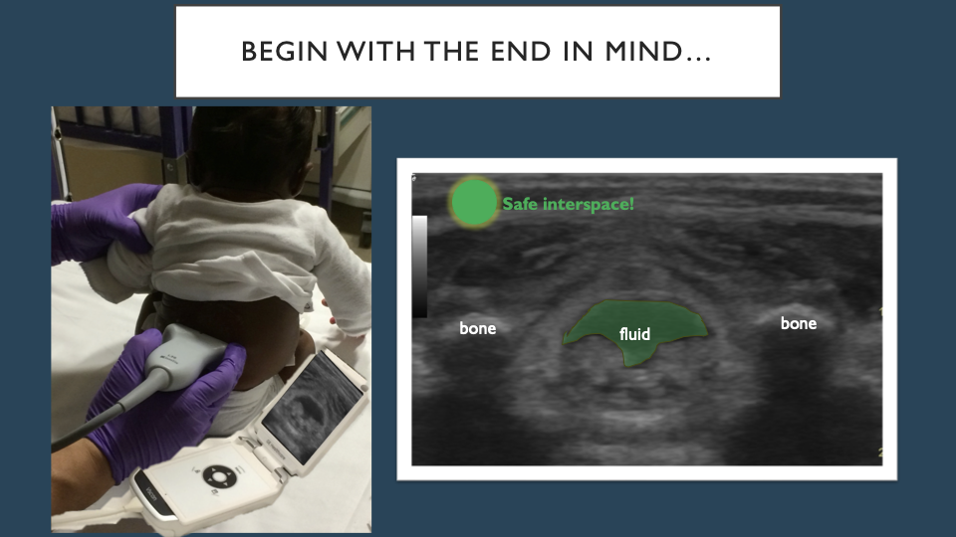

Slide 12
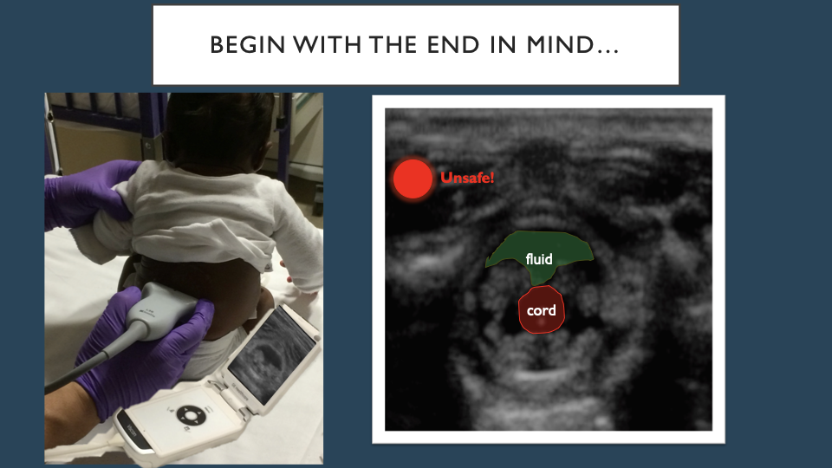

Slide 13
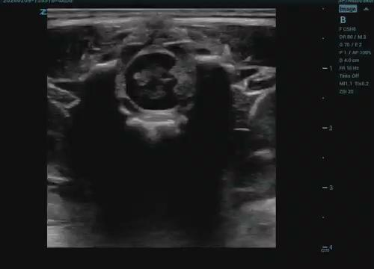
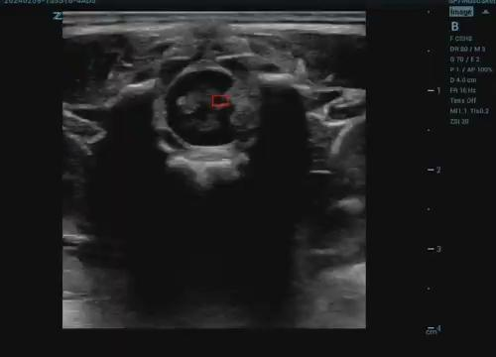
Proof of concept- real time deployment

Slide 14
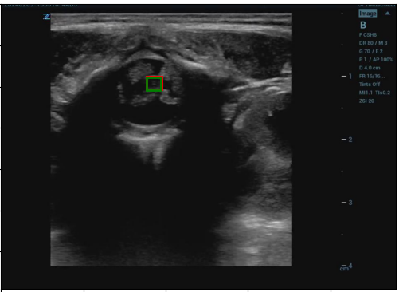
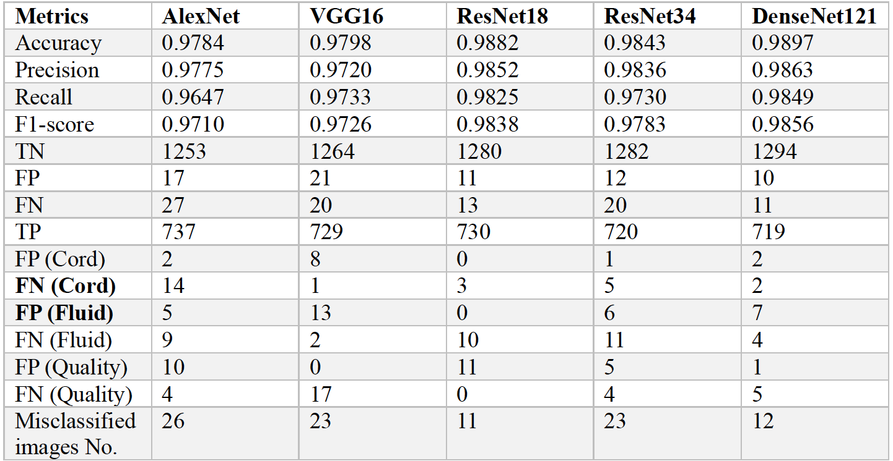
What have we done?
Trained a multilabel image classifier with 3 labels (Bad Quality, Fluid and Cord)
Achieved stellar performances on the hold out test set but the model fails to generalize on new videos.
Did a lot of experiments with multi label classification with different sets of labels
Hypothesis - Overfitting/wrong code implementation/new videos are vastly different from the old one
Object detection model to detect spinal cord (Qualitative evaluation in progress)

Slide 15
What are we trying to do?
Fine tune models
Optimize speed for real time deployment

Slide 16
Database details and Technical milestones
Technical aims/milestones
Overall goal - Use sophisticated architectures and techniques to detect Fluid with highest possible accuracy in real world setting thus overcoming poor generalization of existing model on unseen data.
Current model fails to generalize on new data (Hypothesis - Overfitting/ wrong code implementation/new videos are vastly different from the old one/ model not complex enough? ). Figure out the reason.
Combine fluid detection with spinal cord detection so that both are happening simultaneously while the videos is running.
Timeline - Conclude all technical contributions by somewhere between November 30. Commence documentation (report and poster) on December 1 and complete by December 5
Database details (number of annotated images etc)
Old videos (13 videos with 3390 frames and 3 labels per frame)
New videos (14 videos with 1187 frames and 5 labels per frame)
Data access details (Google Drive)
Credentials and details will be shared post meeting

Slide 17
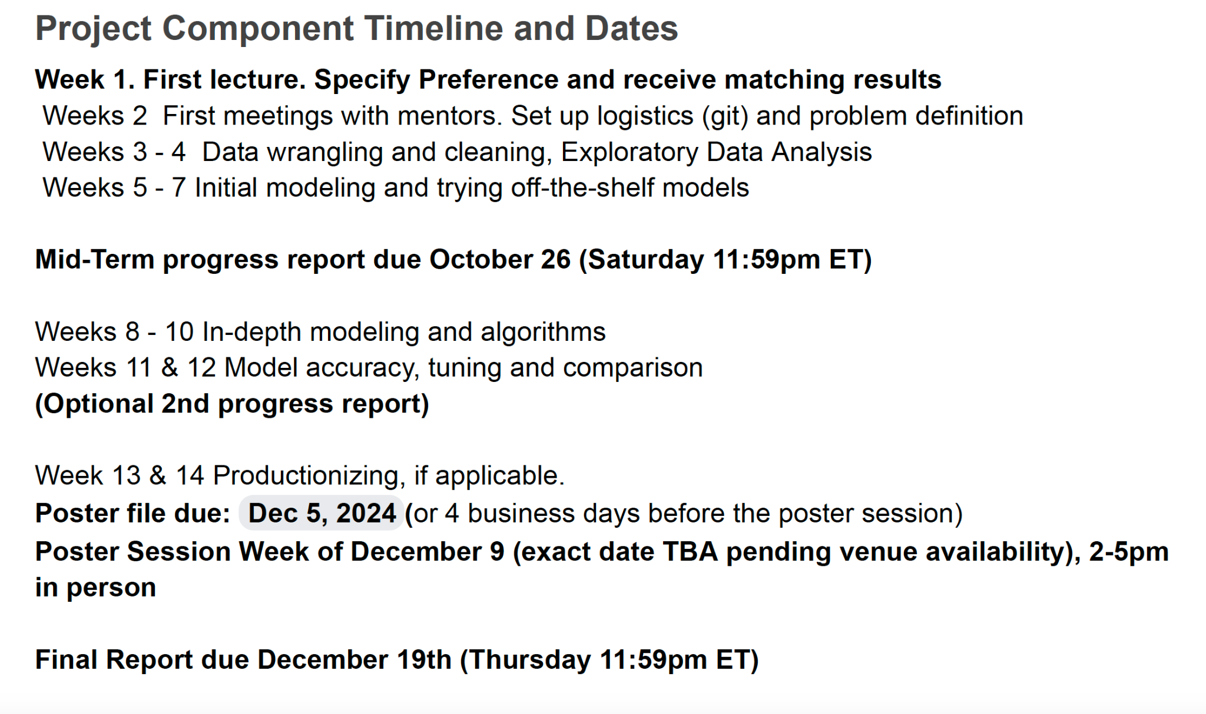
Goals/expectations?

Slide 18
Weekly check-ins
Technical advisor: Ritvik Khandelwal
Content expert: David Kessler
Regular meeting time: monday 10am?

Slide 19
References
Preprocedural Ultrasound for Infant Lumbar Puncture: A Randomized Clinical Trial
https://pubmed.ncbi.nlm.nih.gov/29645365/
The Sonographic Appearance of Spinal Fluid at Clinically Selected Interspaces in Sitting Versus Lateral Positions
https://pubmed.ncbi.nlm.nih.gov/27482967/

Slide 20

David Kessler
dk2592@cumc.columbia.edu
516-769-3777

Slide 21
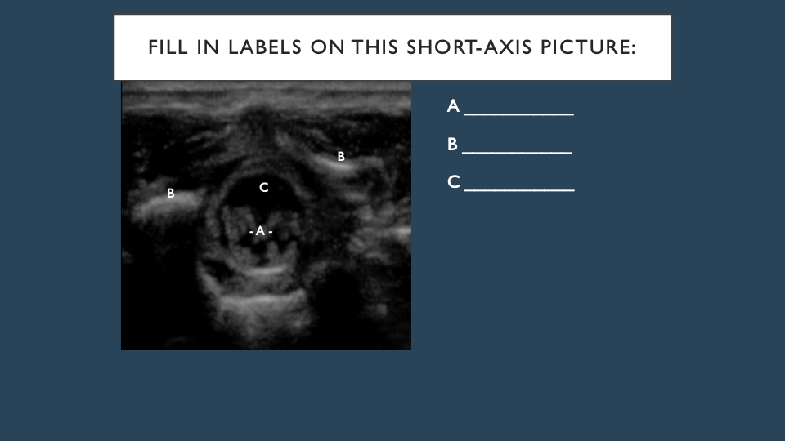

Slide 22
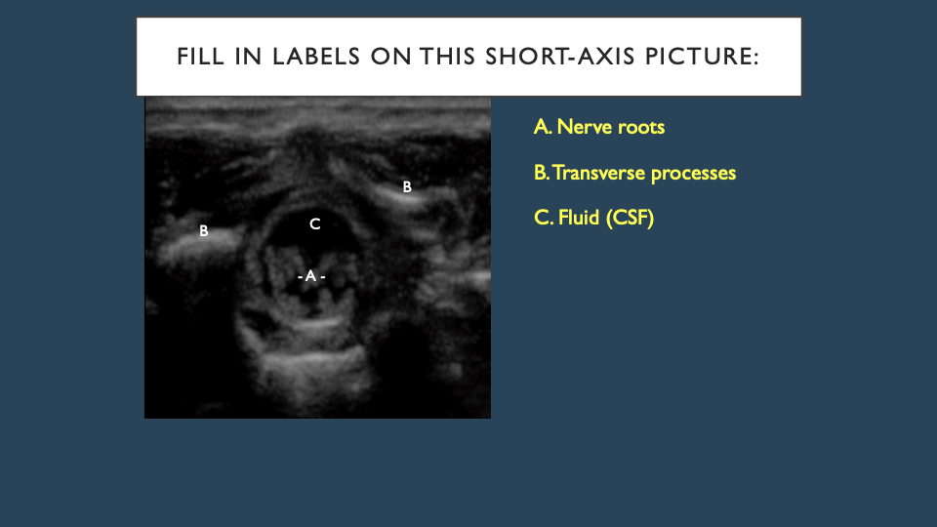

Slide 23
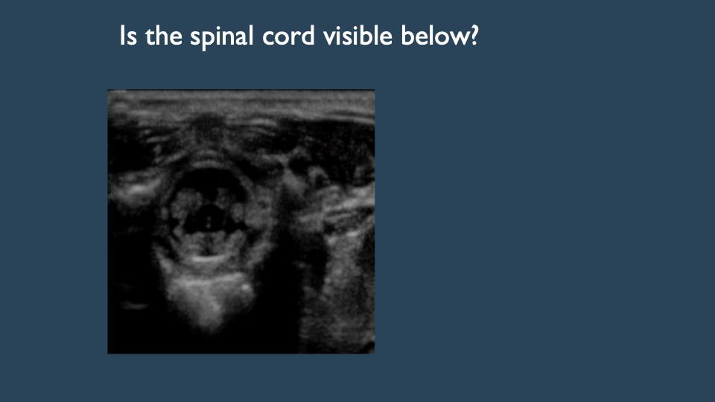

Slide 24
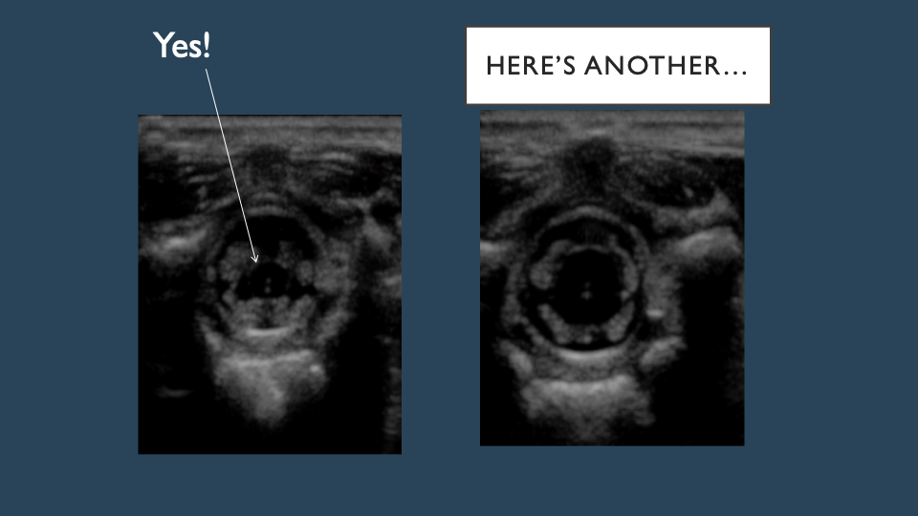

Slide 25
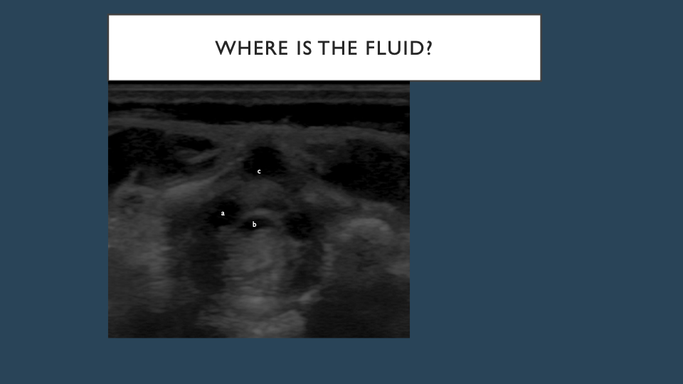

Slide 26
